Slide 1
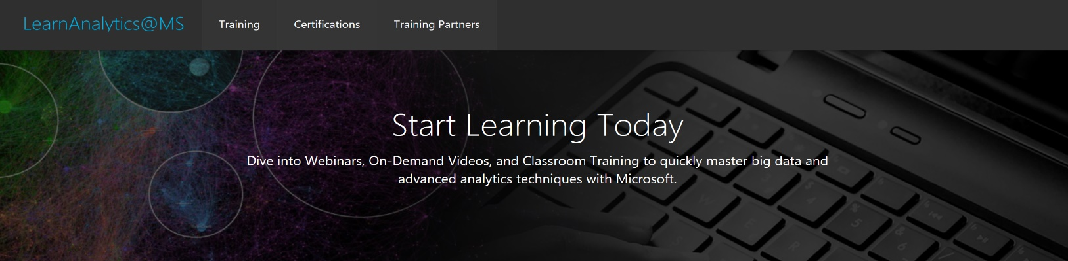

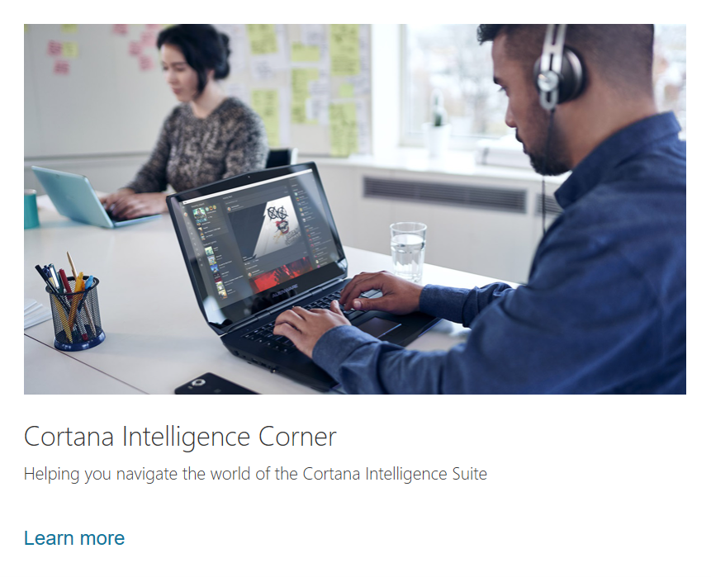




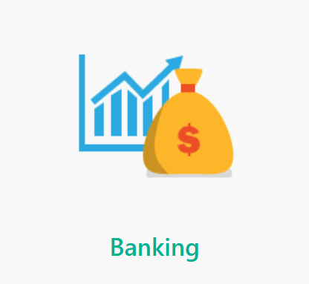
There are more learning options as shown in the links on the right, including:
Online training
Videos
Instructor Led training
Blogs
Cortana Intelligence Gallery

